Slide 1
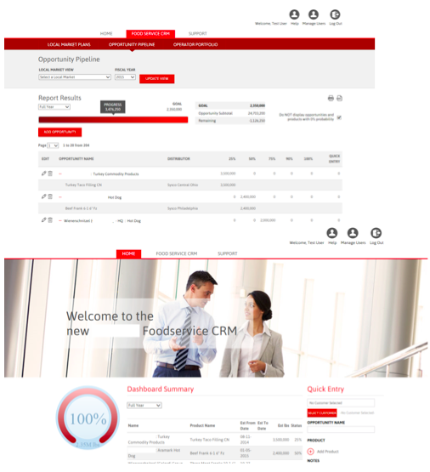
AWP Client Portal
<p>AWP is one of the leading foodservice sales and marketing organizations in the country.&nbsp; They work with manufacturers and their customers to reduce costs and move products, using multiple tools to extend their marketing strategies, data analysis and product expertise.&nbsp; AWP engaged Affirma with building a CRM portal for one of their largest national clients, to provide clearer analysis of their data through a more powerful and intuitive management system.</p>
The Challenge
<ul>
<li>Affirma developed a custom web application that included a data layer, web service layer and a web-based UI. The team designed this tool to display sales opportunities in a hierarchal manner, with filters and expand/collapse functionality for easy consumption of details.&nbsp; Users can quickly enter opportunities and view their progress on their customized dashboard.&nbsp;</li>
<br />
<li>We also built a cascade mechanism for their leadership to plan target goals for the entire company, with historical reference and automated roll up.</li>
</ul>
What We Did
Results
<p>This solution has greatly improved the visibility of sales opportunities and removed pain points for entering and consuming data. AWP&rsquo;s client is better able to manage their sales calls, sales opportunities, white space, and reporting because of this successful initiative.</p>

